Slide 1
Recording a Game of Go
Steven Scher & Ryan Crabb
sscher@ucsc.edu
Course Project for UCSC CMPS 290b, Fall 2007
Prof. James Davis

Slide 2
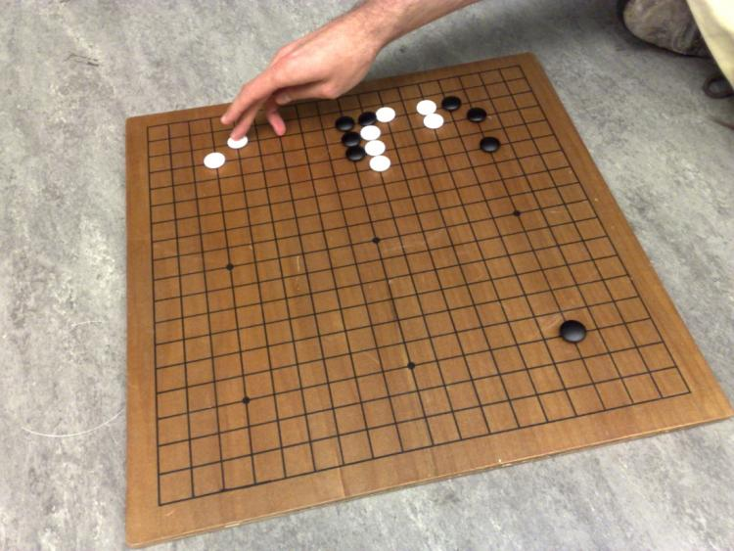
A Typical Go Game
Black Stones
White Stones

Slide 3
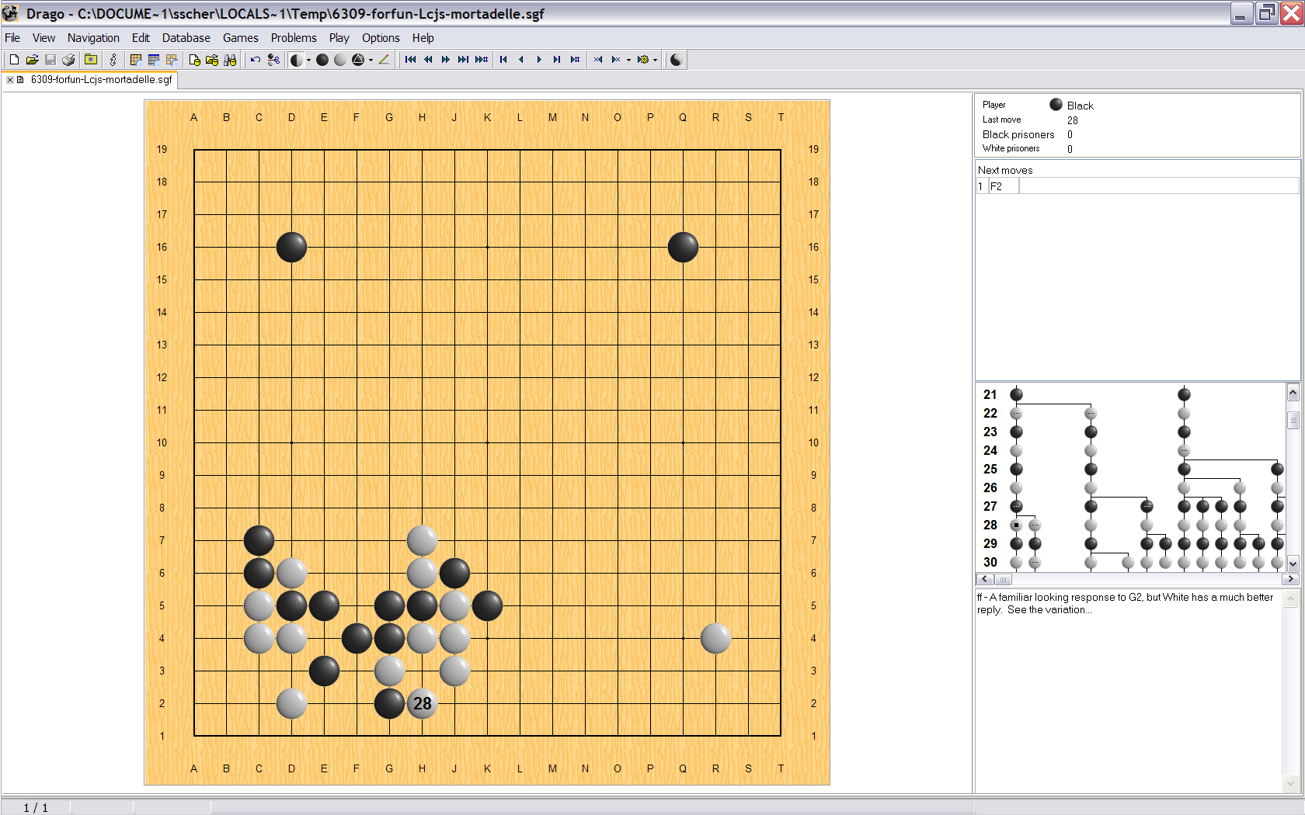
Typical Game Review

Slide 4
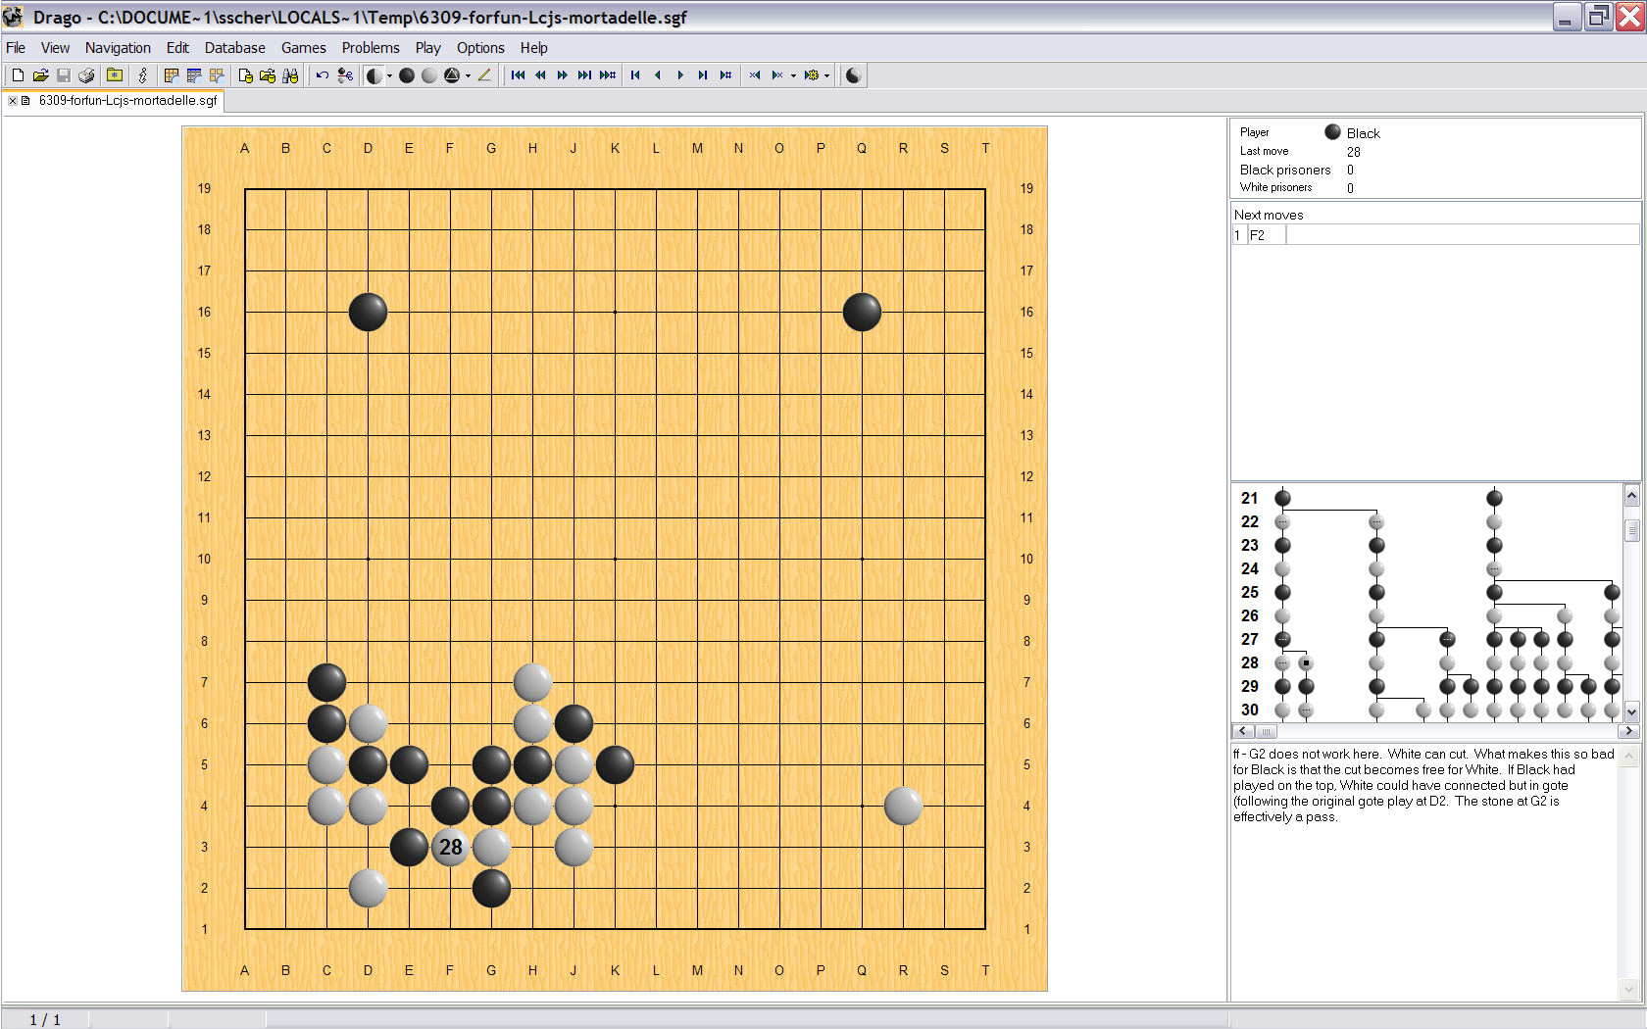
Typical Game Review

Slide 5
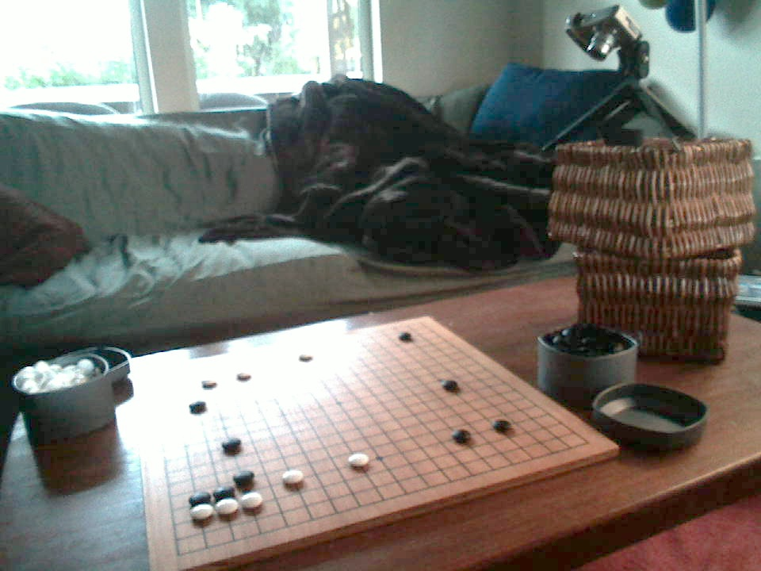
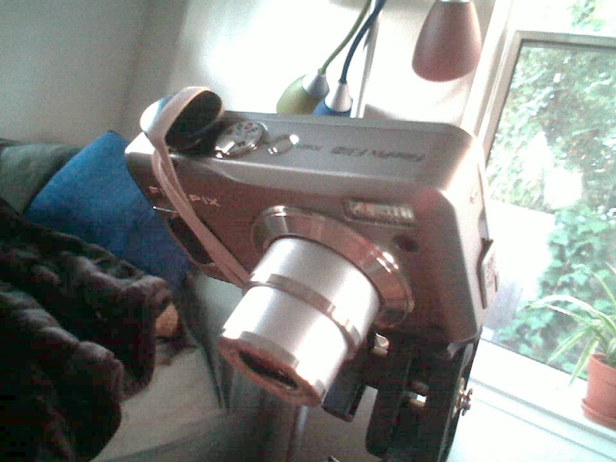
Recording a Game

Slide 6
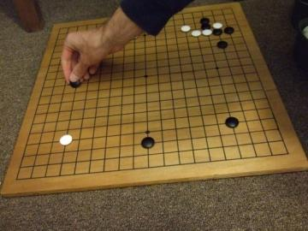
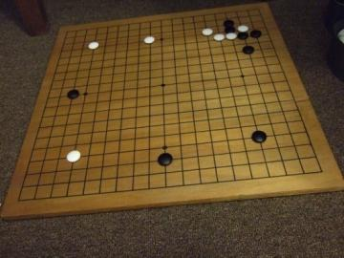
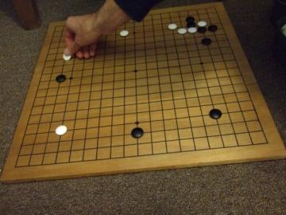
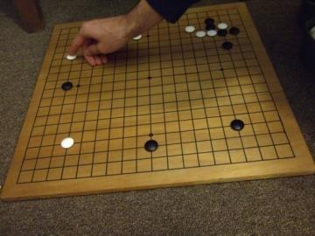
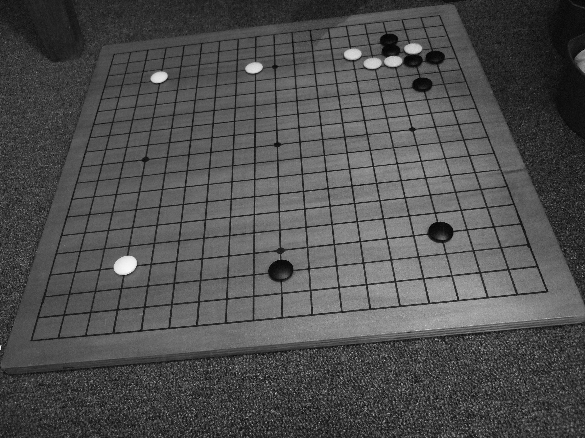
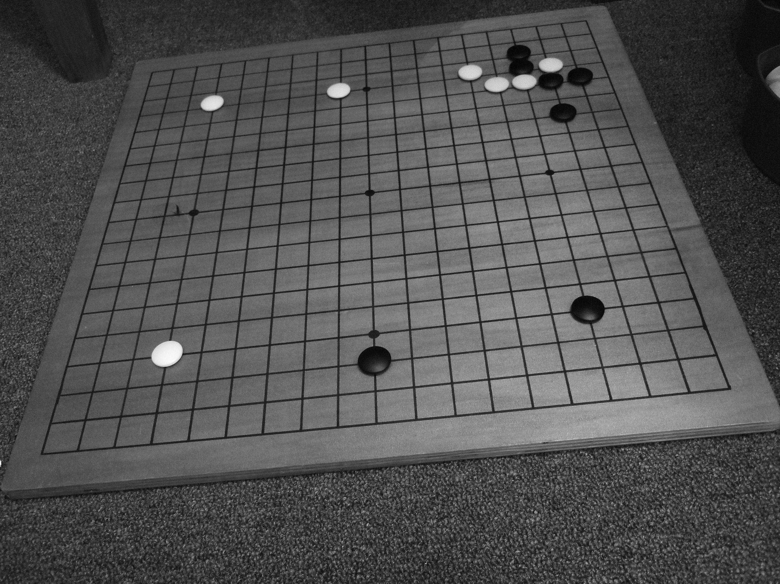
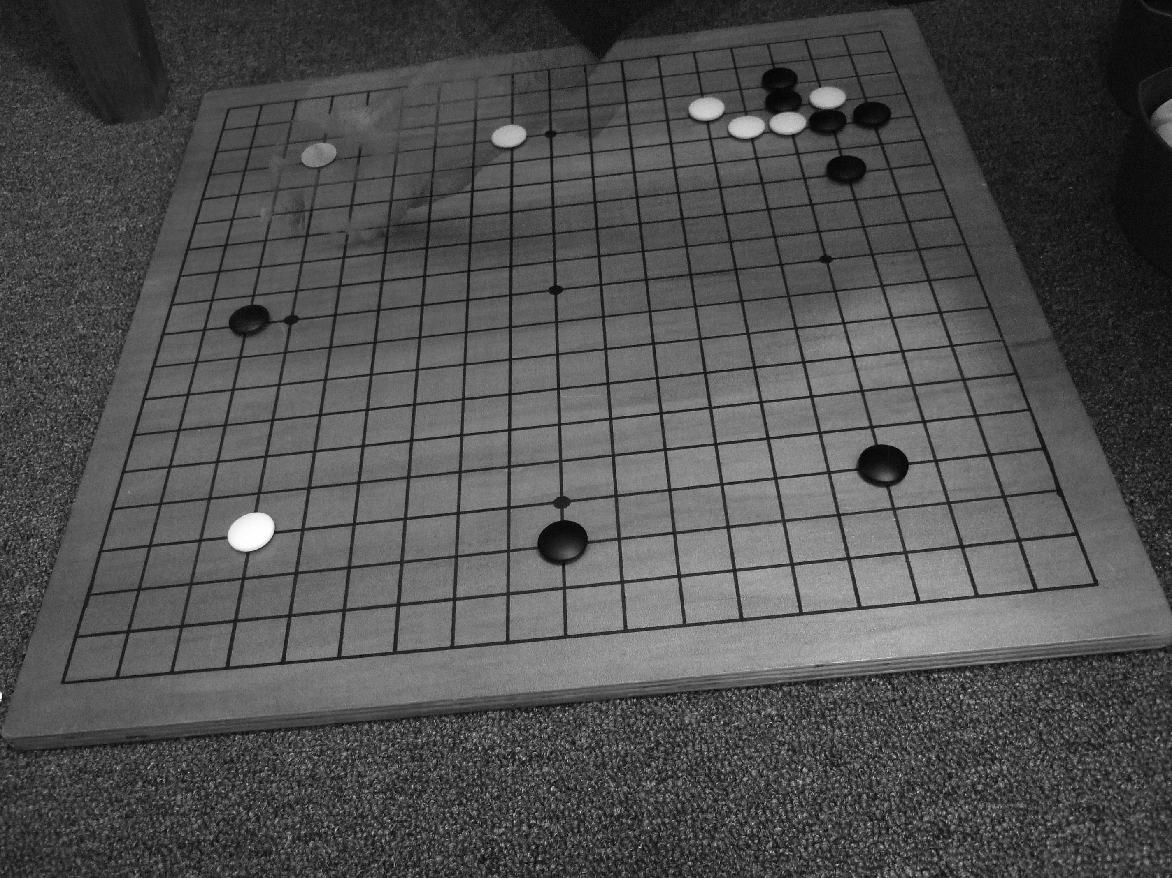

Ignoring Hands

Slide 7
Detecting Lines

Slide 8
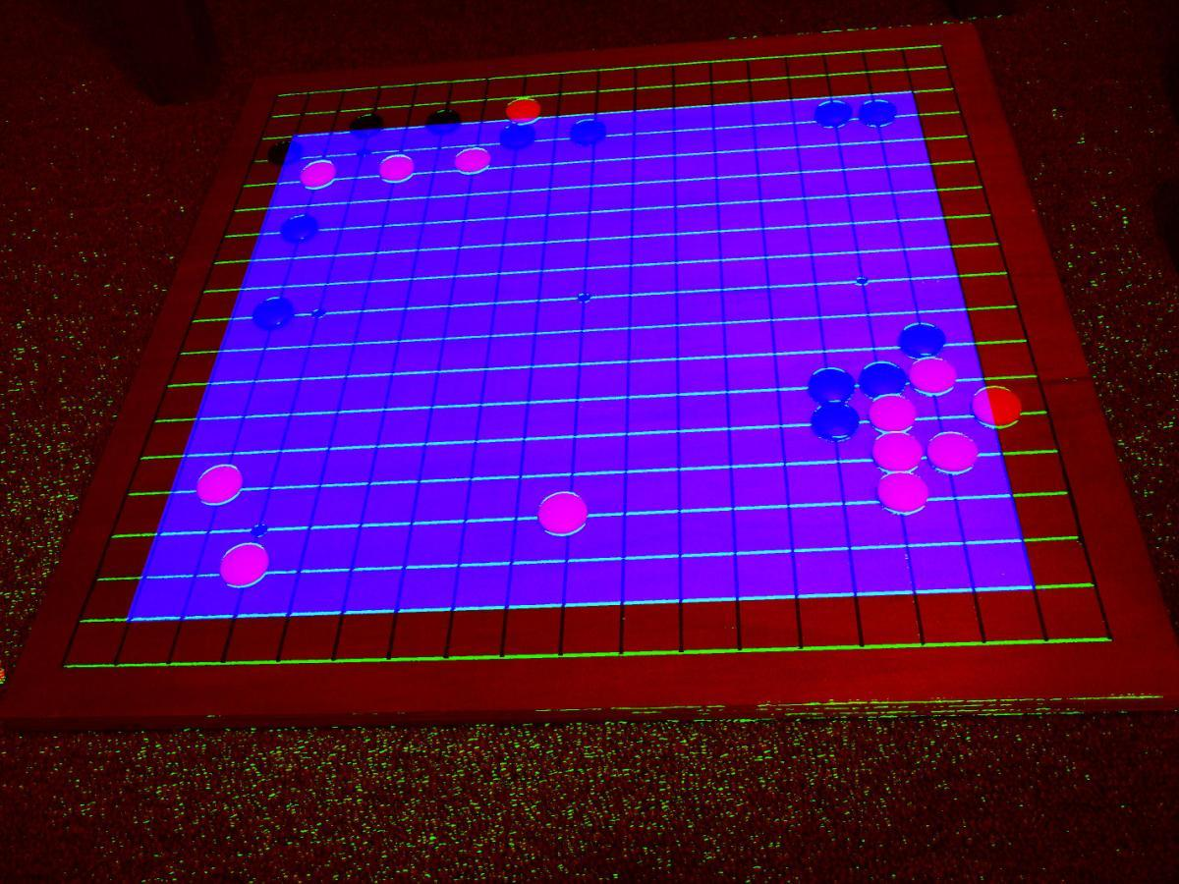
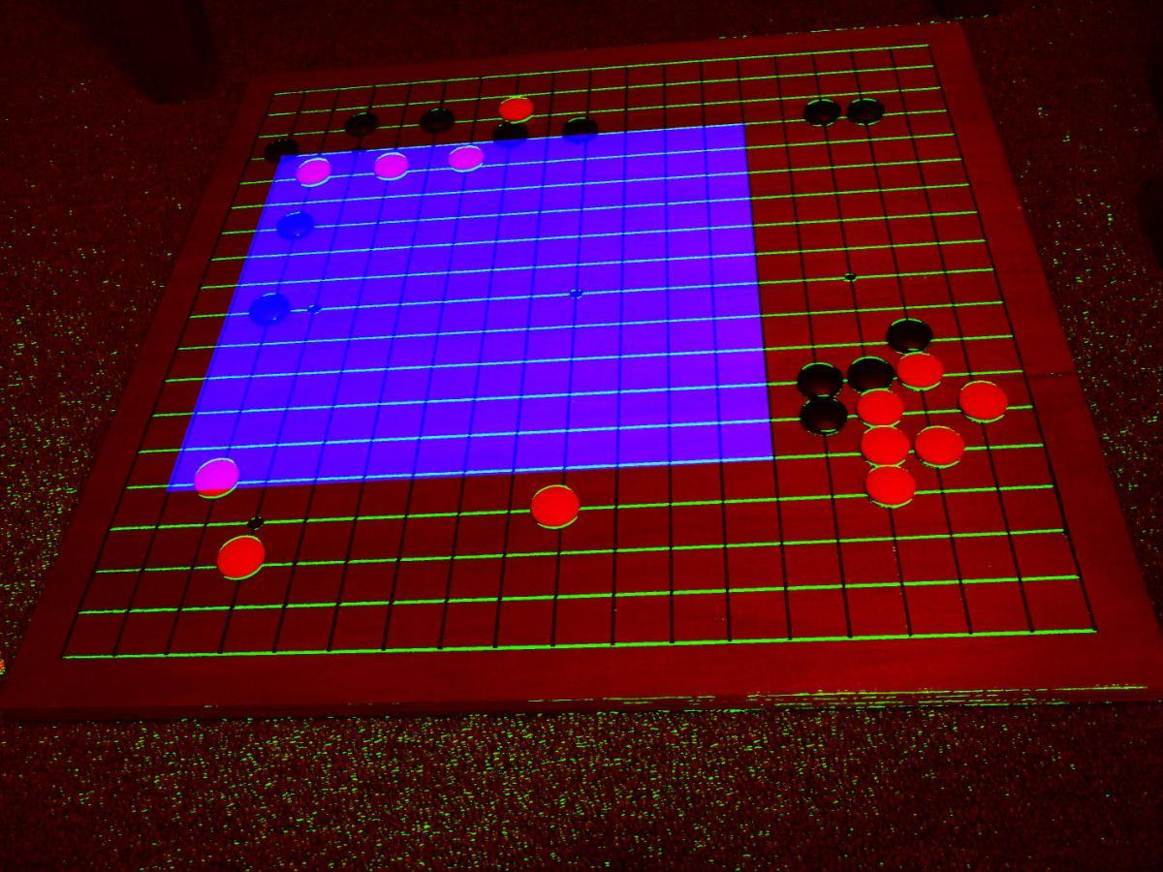
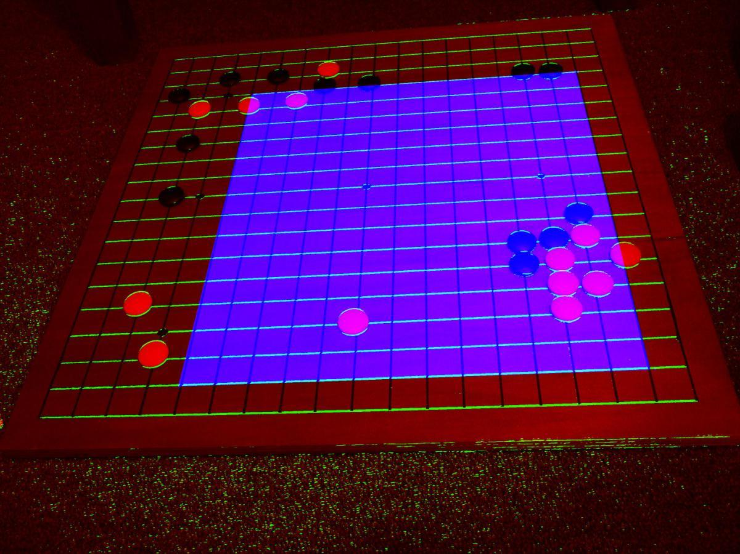
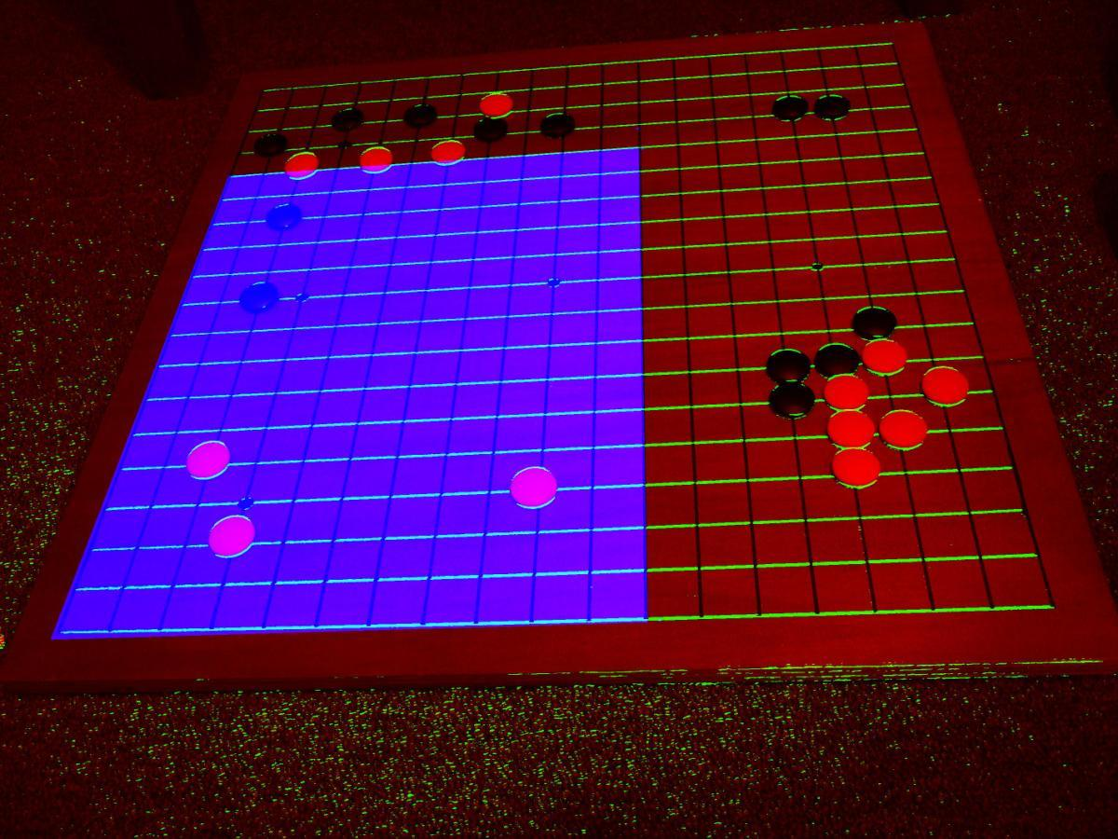
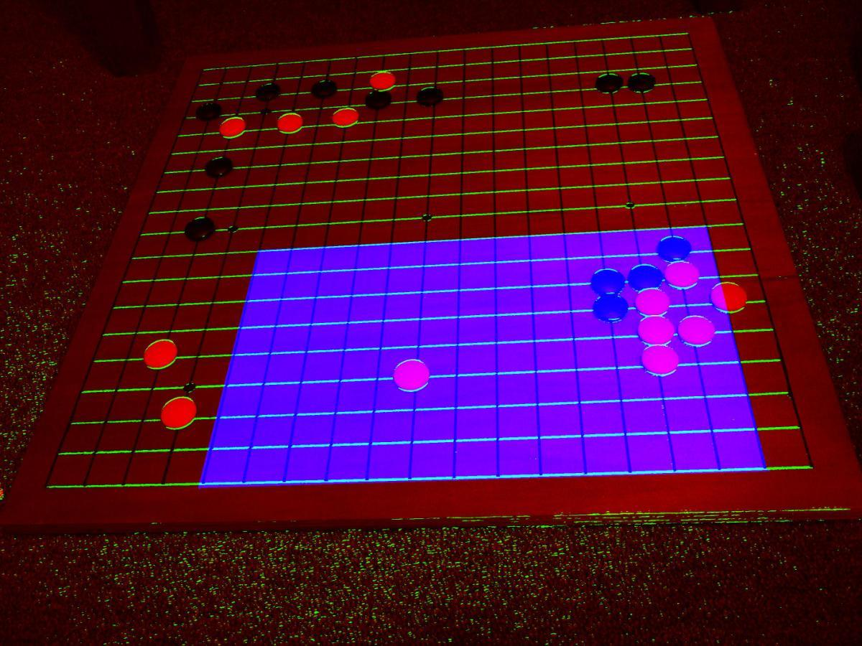
RANSAC: Try a pair of pairs of lines

Slide 9
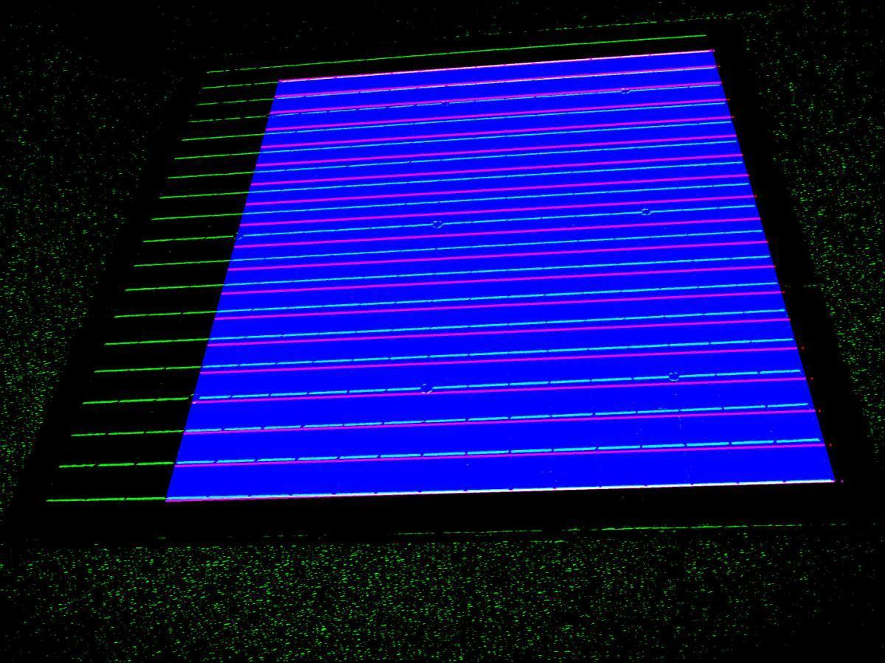
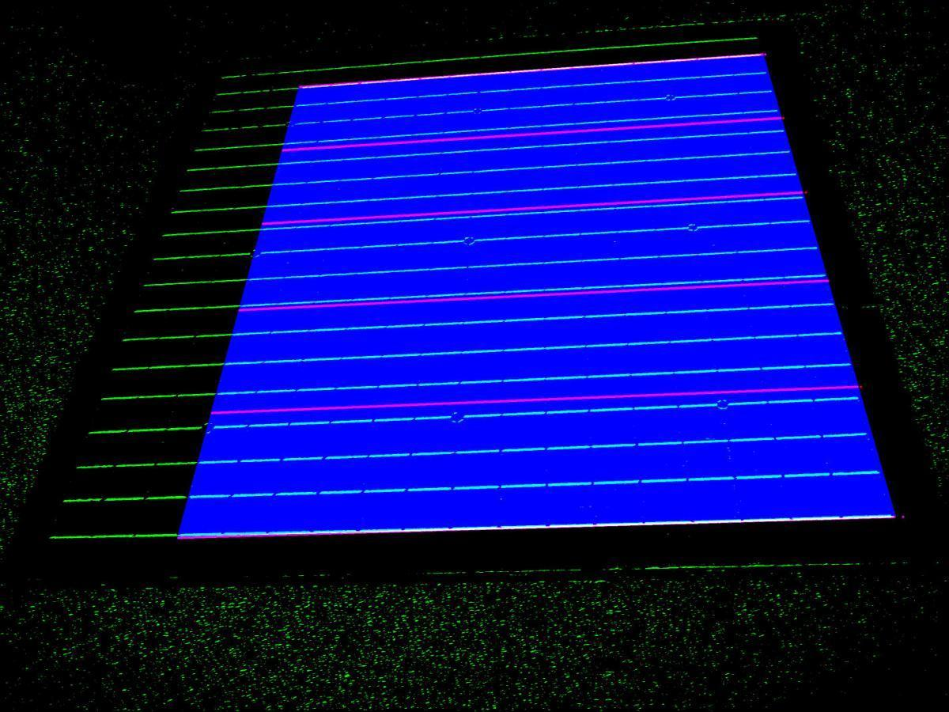










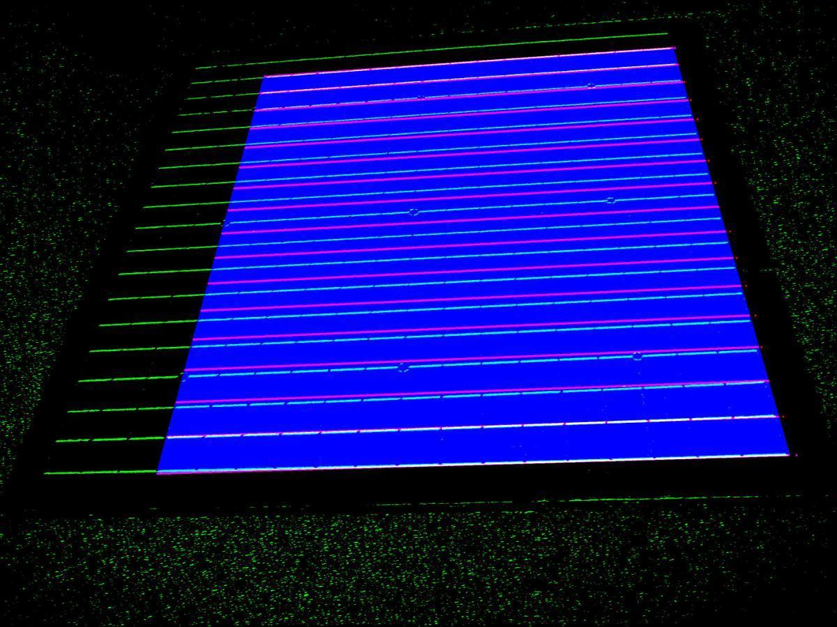

Ransac - Guess Spacing

Slide 10
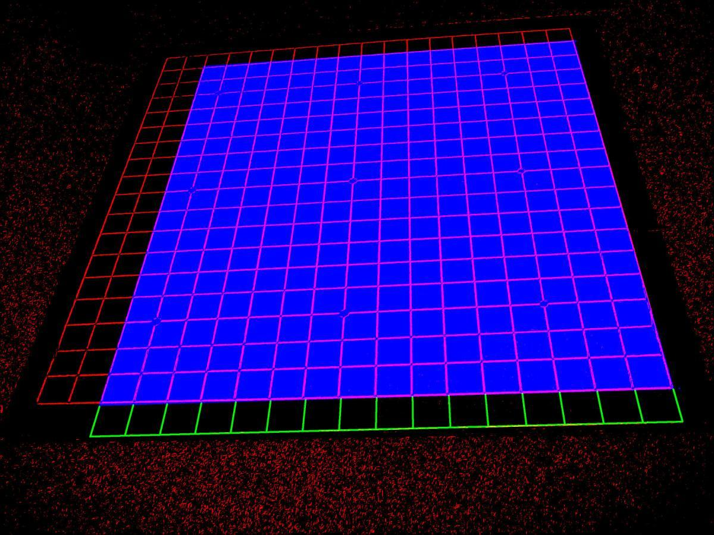
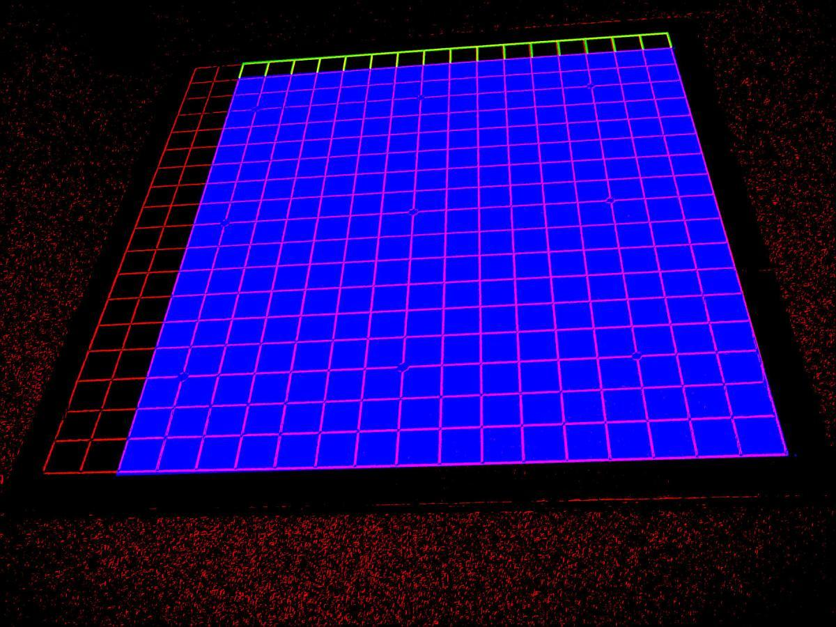
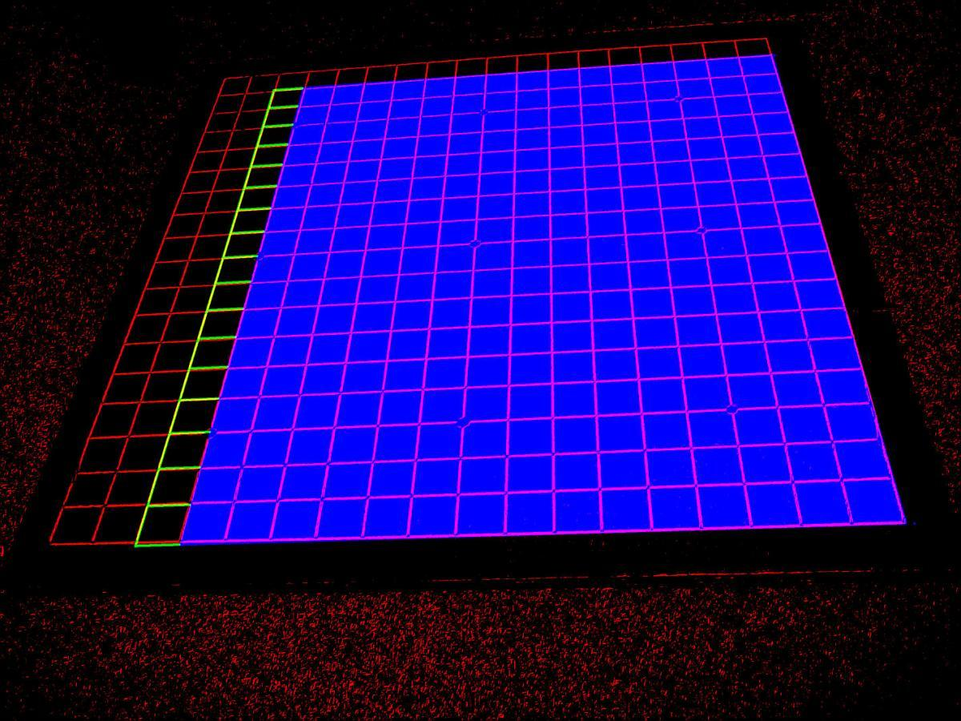
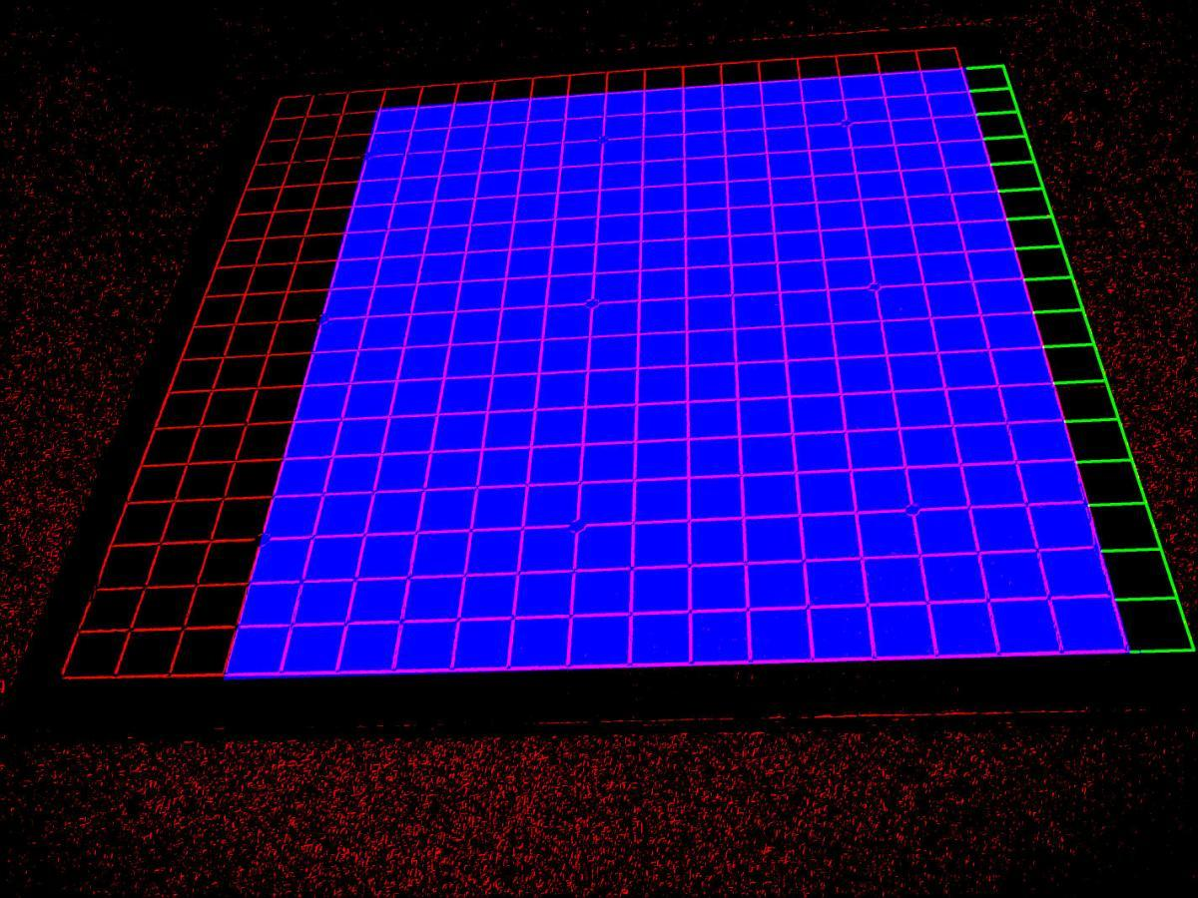
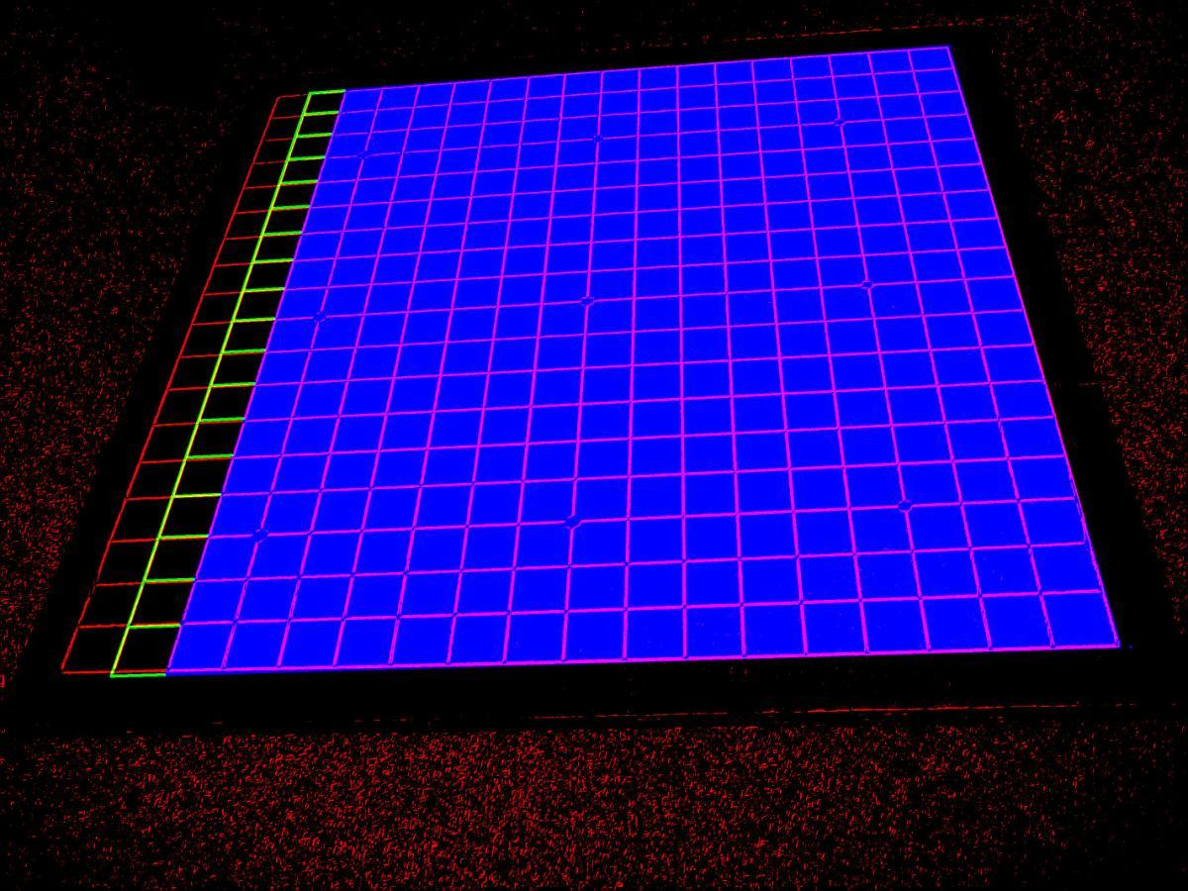
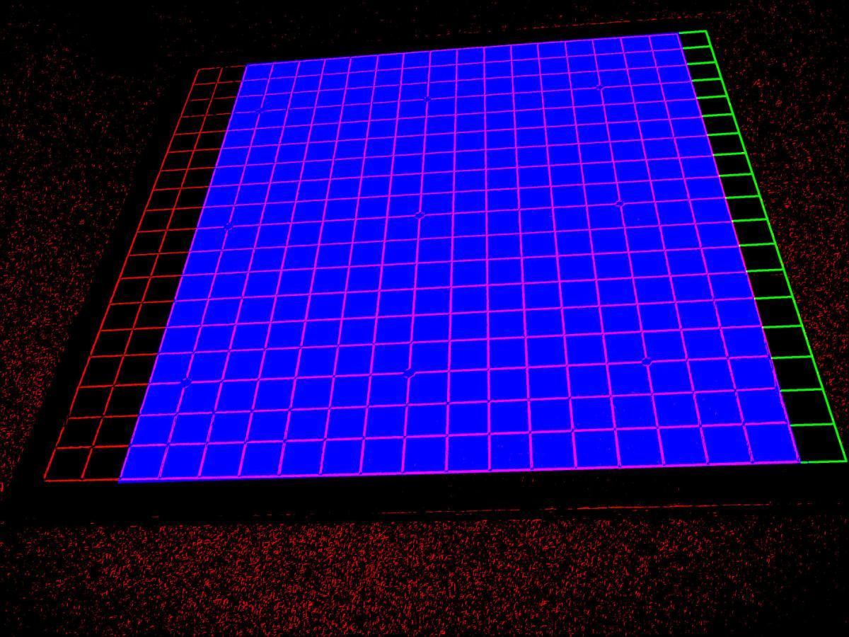
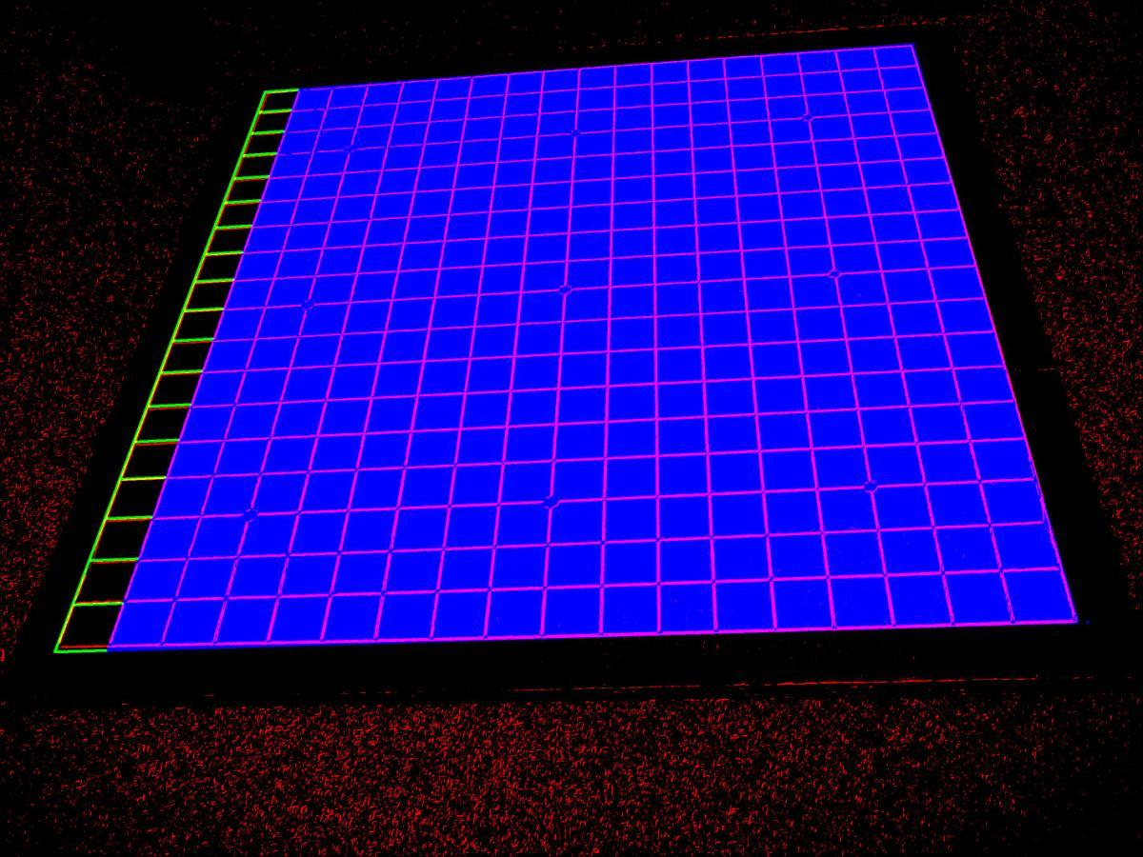
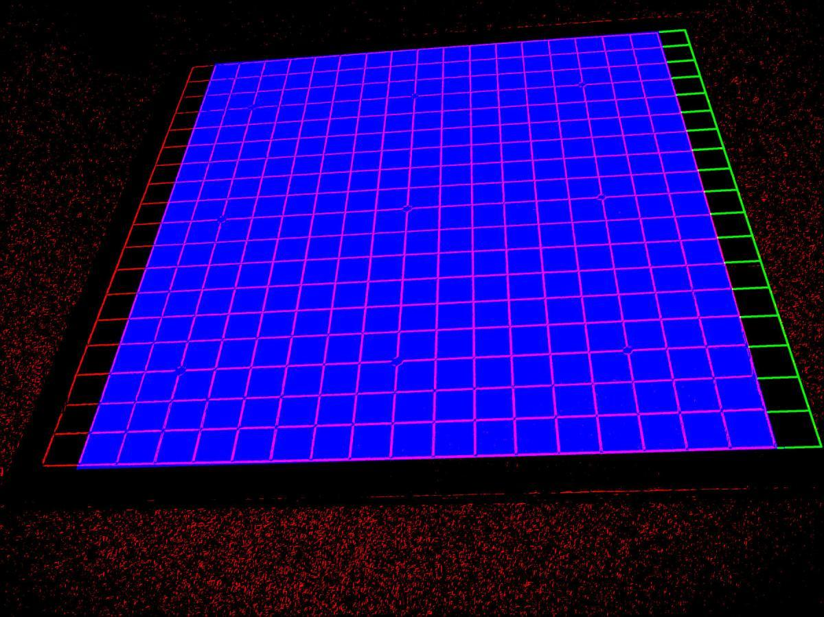
Grow Grid - Greedy

Slide 11
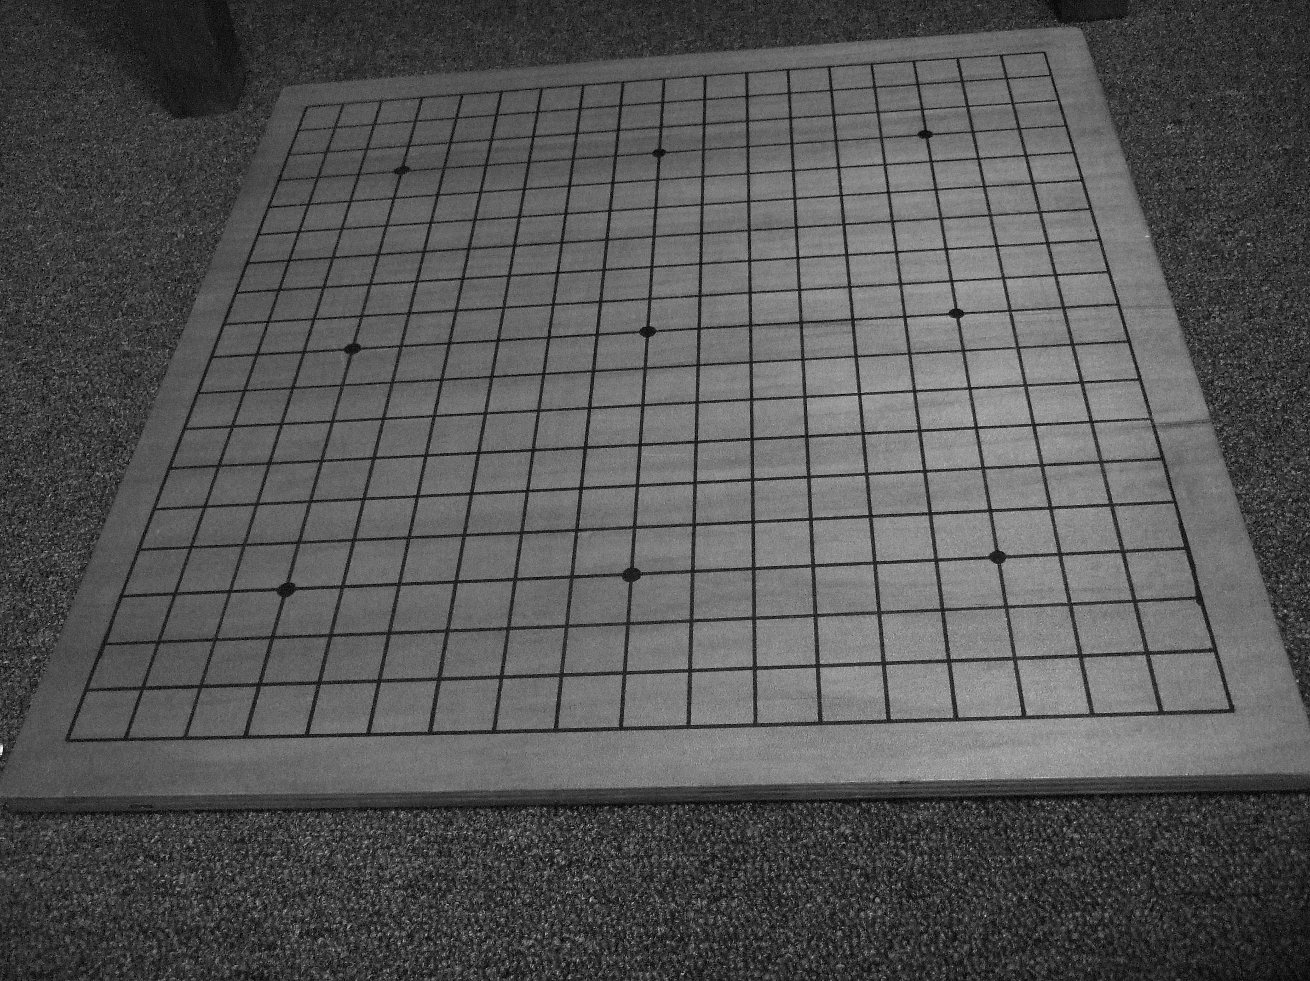
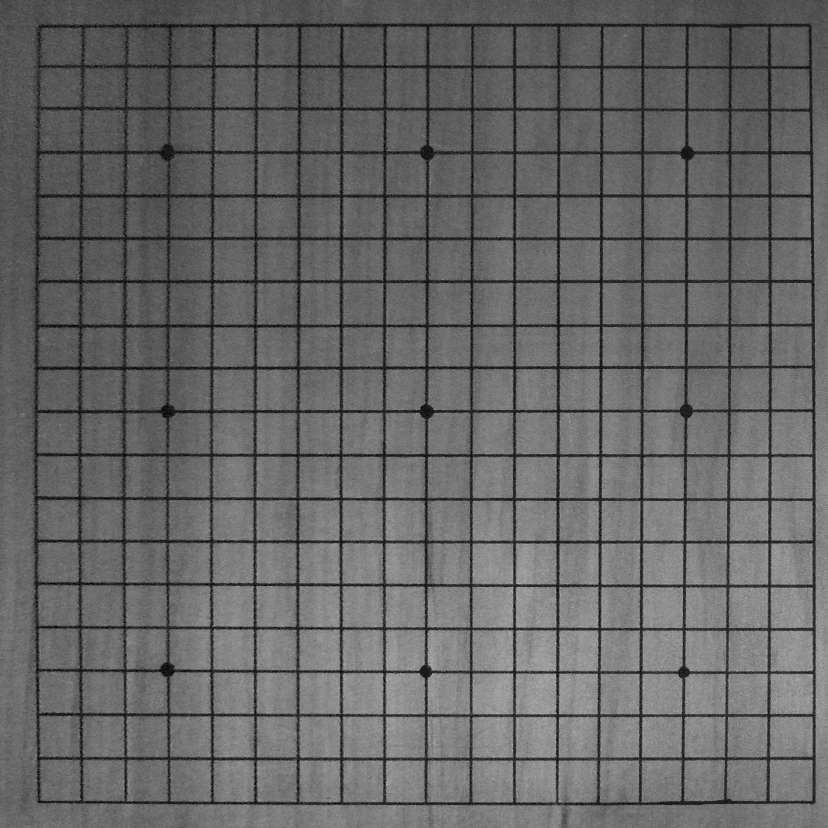
Rectify Image

Slide 12
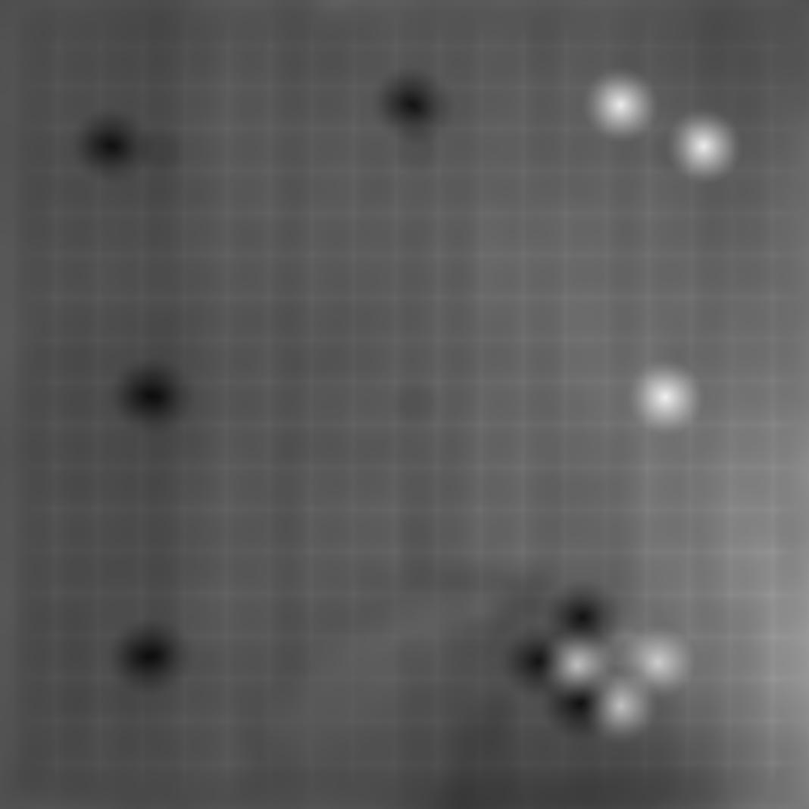
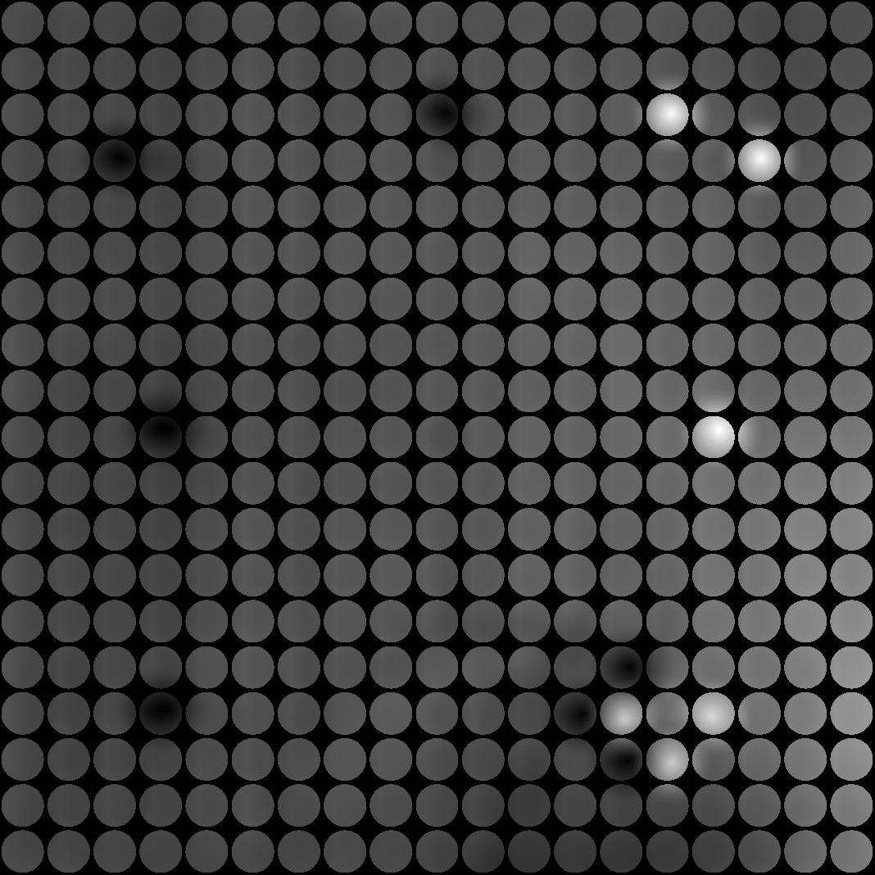

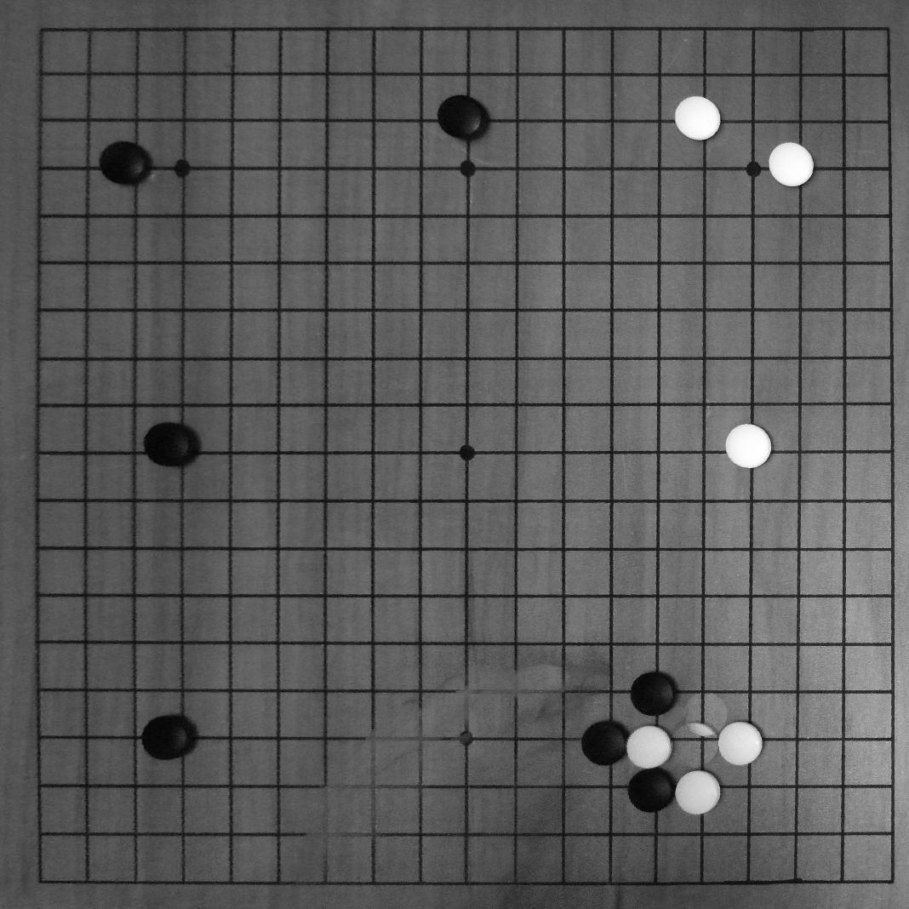
Linear Filter == Template Matching

Slide 13
Result of Raw Stone Detector
Play movie vid1.avi

Slide 14
Optimal Move Sequence is a shortest path
.9
.1
.2
.8
.9 .7
.8 .8
Time = 1
Time = 2
Time = 3

Slide 15
Optimal Move Sequence: Graph of all Possible Sequences
.821
.014
.002
.403
.201
.350
Time = 1
Time = 2
Time = 3

Slide 16
Optimal Move Sequence is a shortest path
.821
.014
.002
.403
.201
=.066
.350
Time = 1
Time = 2
Time = 3

Slide 17
Greedy, Iterated Depth-Limited Search

Slide 18
Optimal move sequence
Play movie vid2.avi

Slide 19
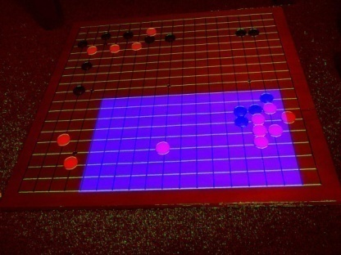
Moral of the Story

Slide 20
Future Work
Better Stone Detector
Use Gradients to find first 6 stones
Train SVM on first 6 stones
Faster Shortest-Path search
transposition table
Implement on cell phones
Detect Board
Detect Stones in Real-Time
Send detection probabilities to Server

Slide 21
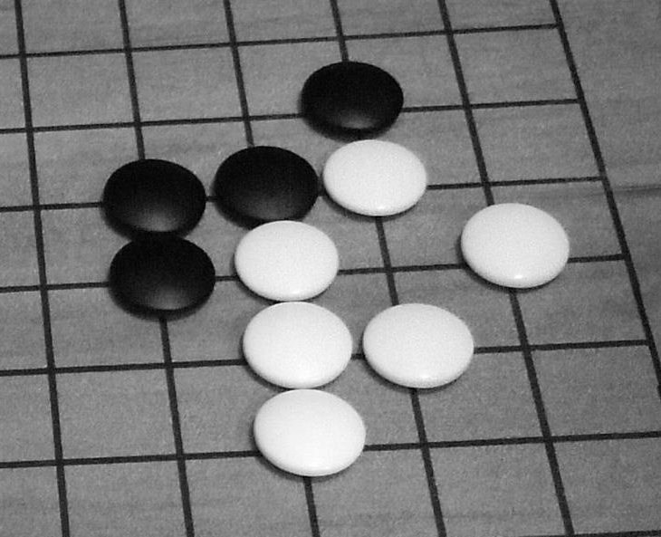
Hard Cases Brightness vs Gradients
Brightness:
One Stone or two?
Gradients of white eye
& black stone similar

Slide 22
Alternative: Transform the circle we’re looking for into the original image space

Slide 23
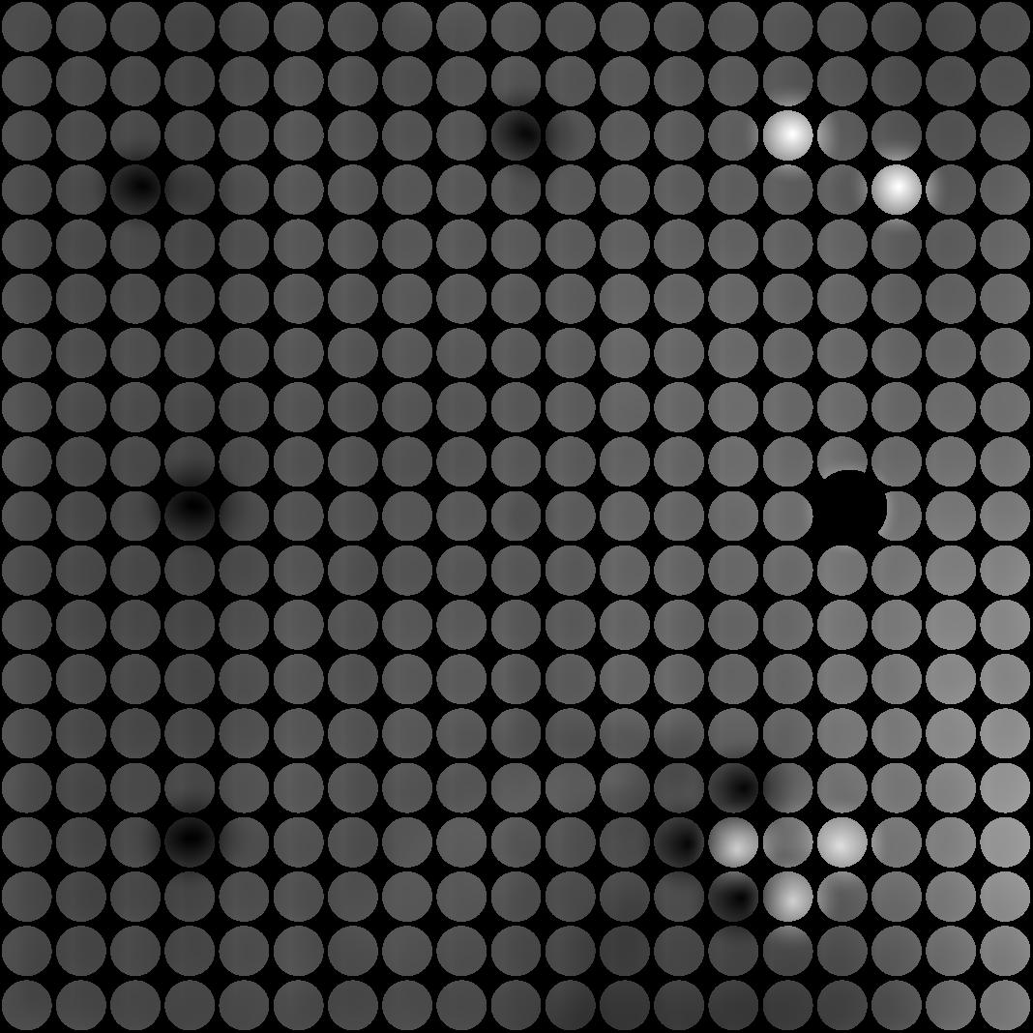
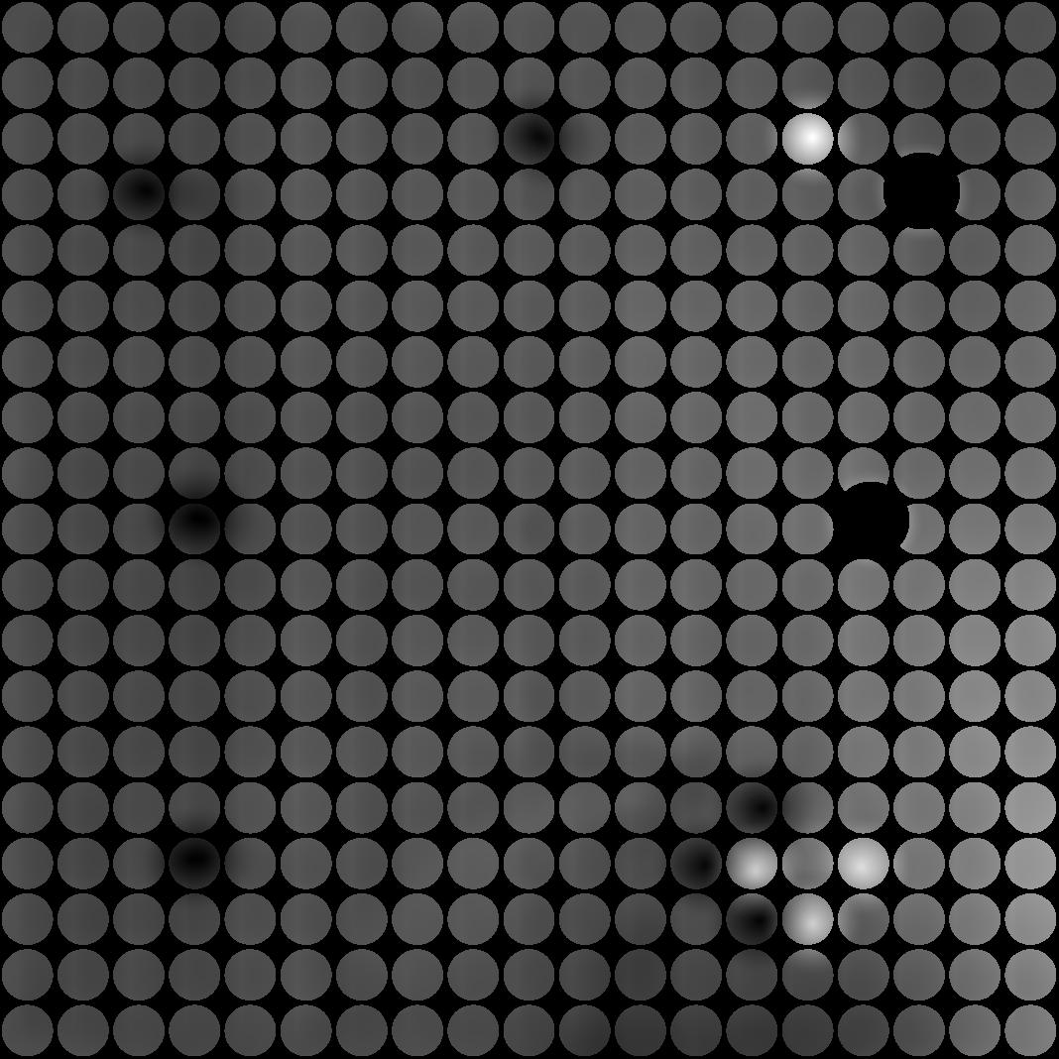
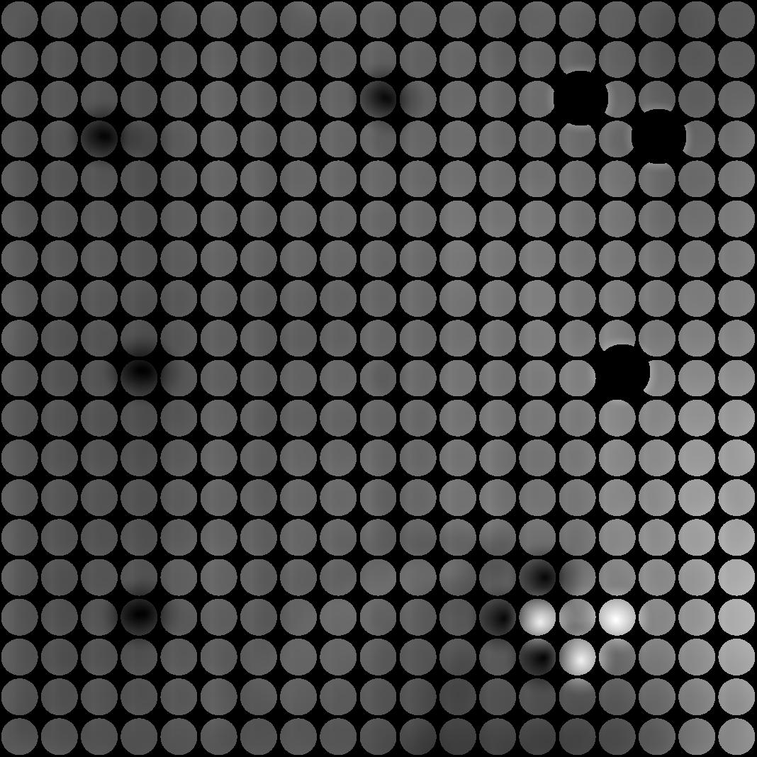
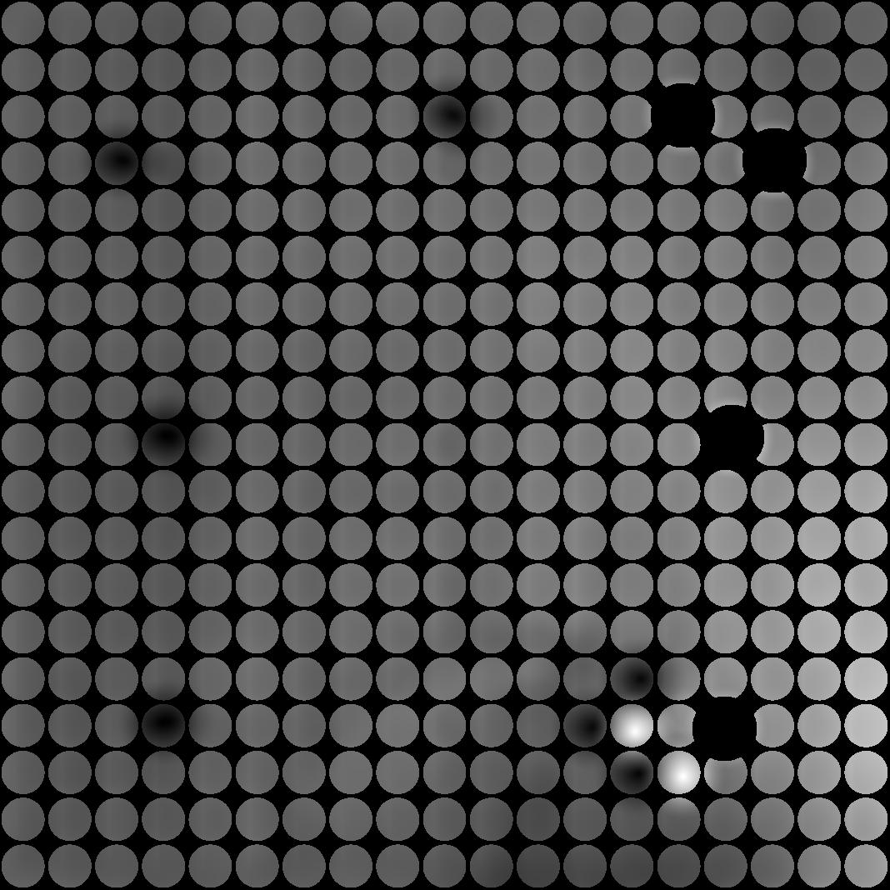
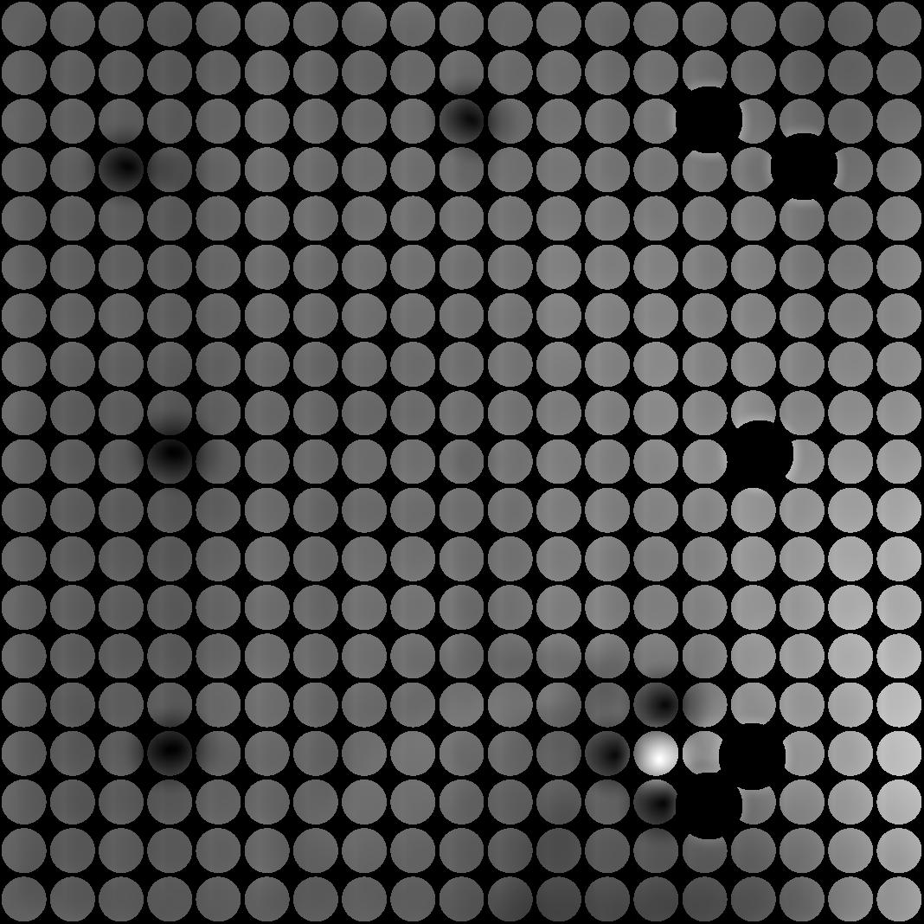
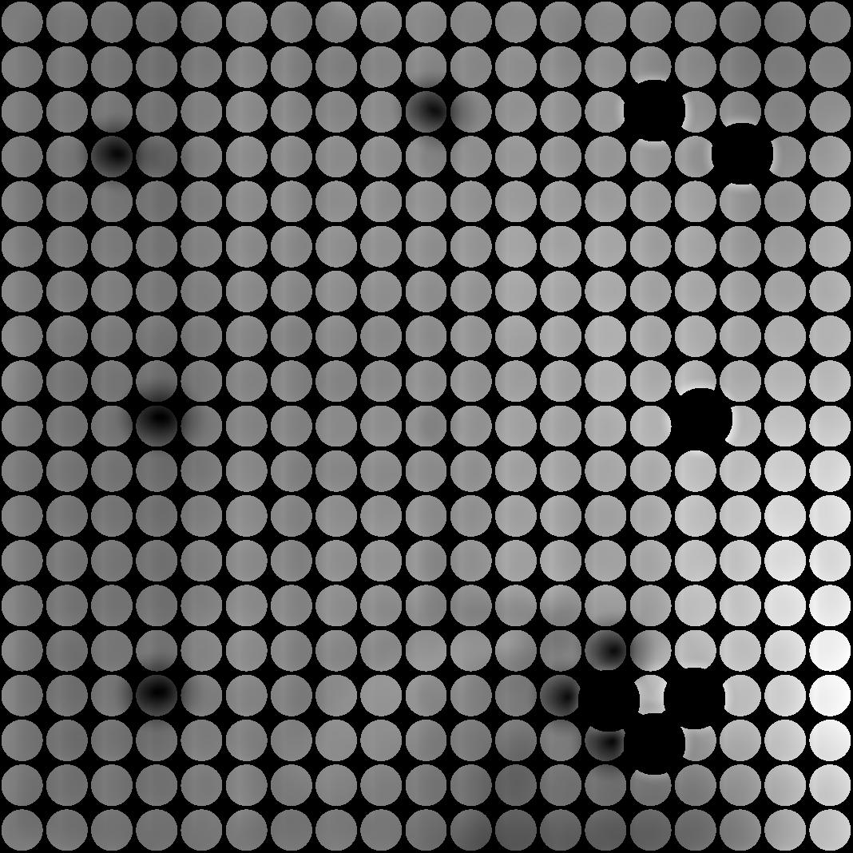

Keep Them Separated

